Slide 1
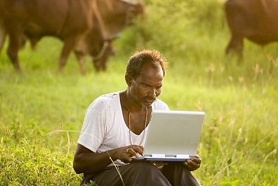
SMART AGRICULTURE
By
Technology At Farms…
Kaveen
Prathap
Nikhil
Hemanth
Guide
Harish V Mekali

Slide 2
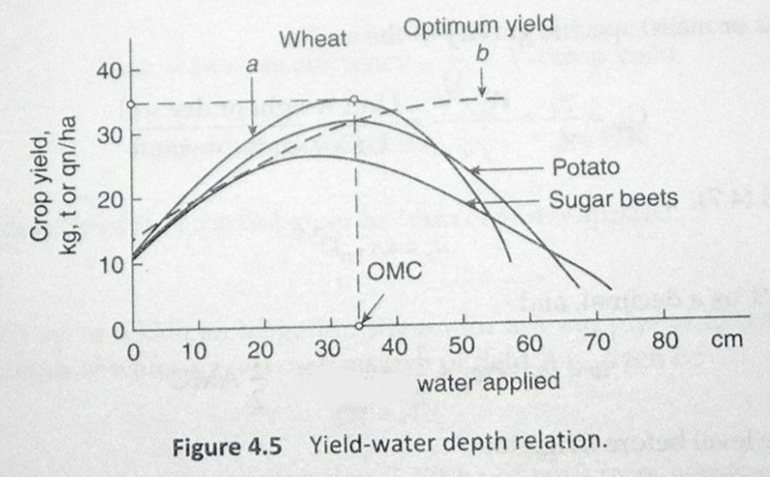
Why?
Optimum Water, More Yield…

Slide 3
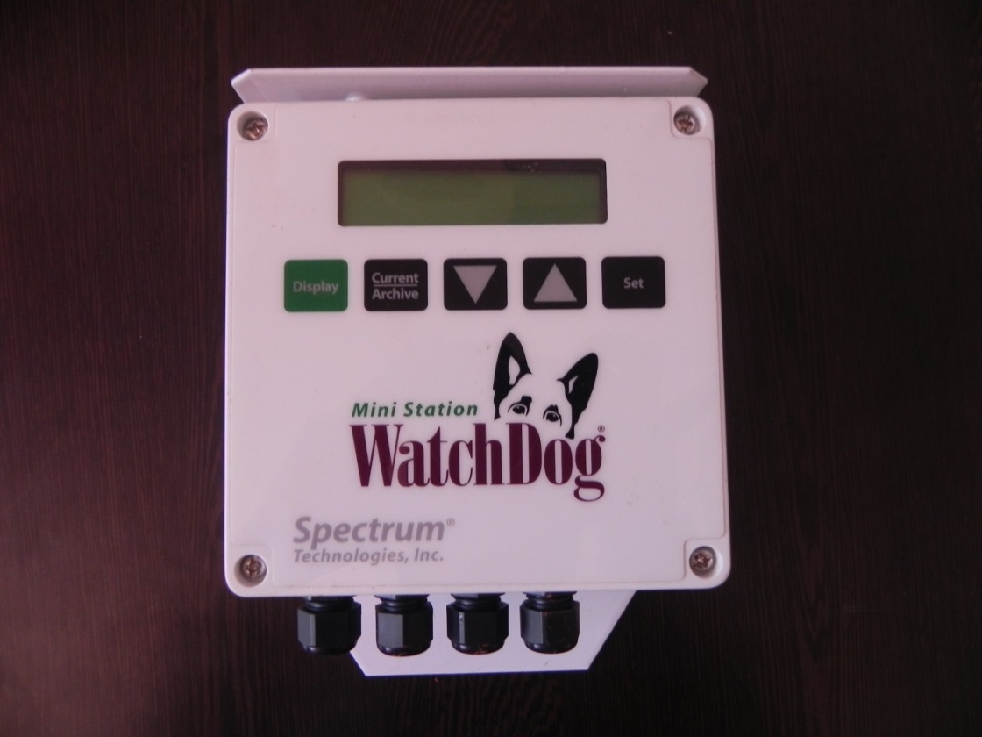
Initialization…
WatchDog
Sensors
4 Soil moisture sensors (SM100)
Data logger
Exclusive LCD Display confirms logger operation and provides current sensor readings. 0
Data transfer
USB to Serial for connecting to your Laptop

Slide 4
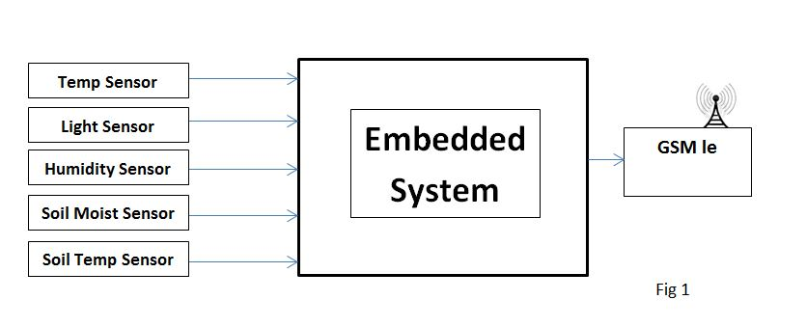
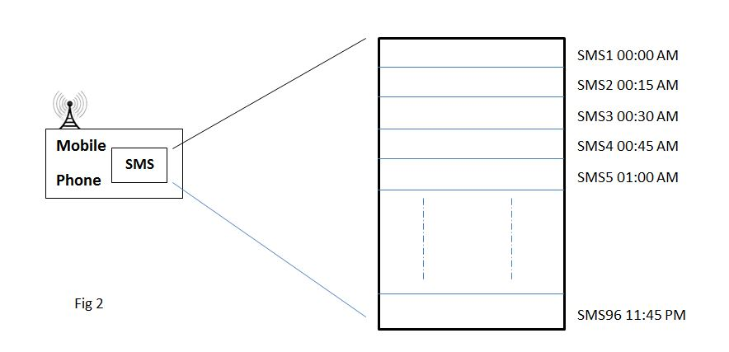
Improvisation…
Weather Monitoring
system
Sensor values read
Read values sent
Base end
Received values at the user’s hands
Temp:29⁰C SM:25% ST:18⁰C Lum:100lux RH:20%
SMS Format
User end

Slide 5
Conceptual Block
REMOTE
STATION
REMOTE
STATION
BASE
STATION
SERVER
REMOTE
STATION
GPRS
REMOTE
STATION
REMOTE
STATION

Slide 6
Base Station…
Internet
Battery
––––
GPRS
Relay
ARM Cortex
Display
Sensors
Memory

Slide 7
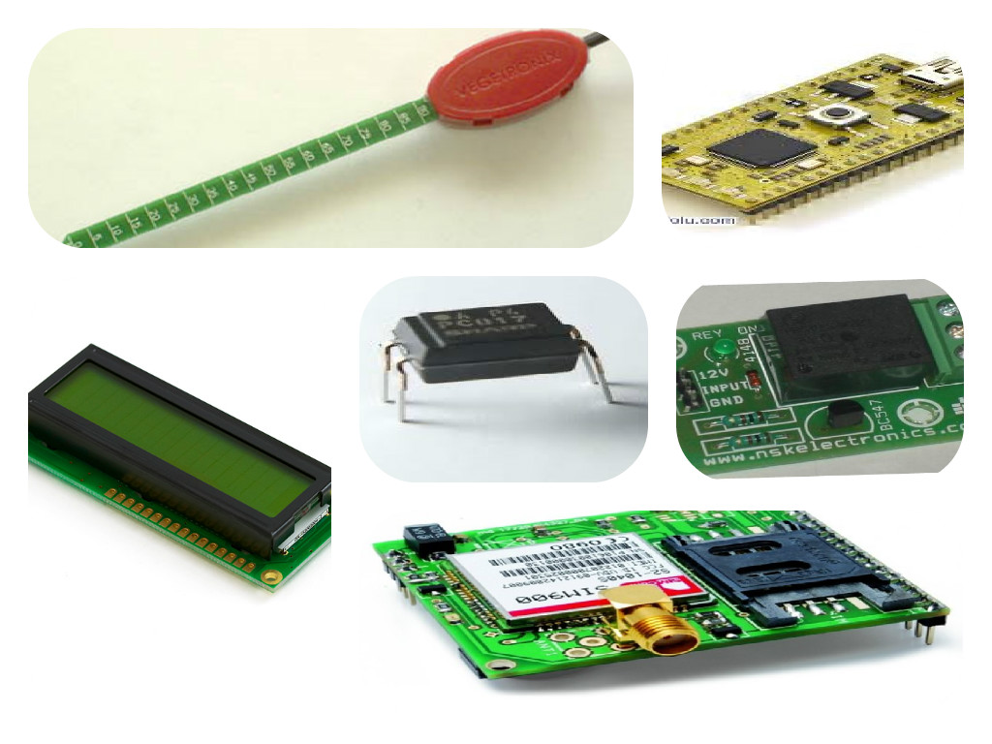
Components…

Slide 8
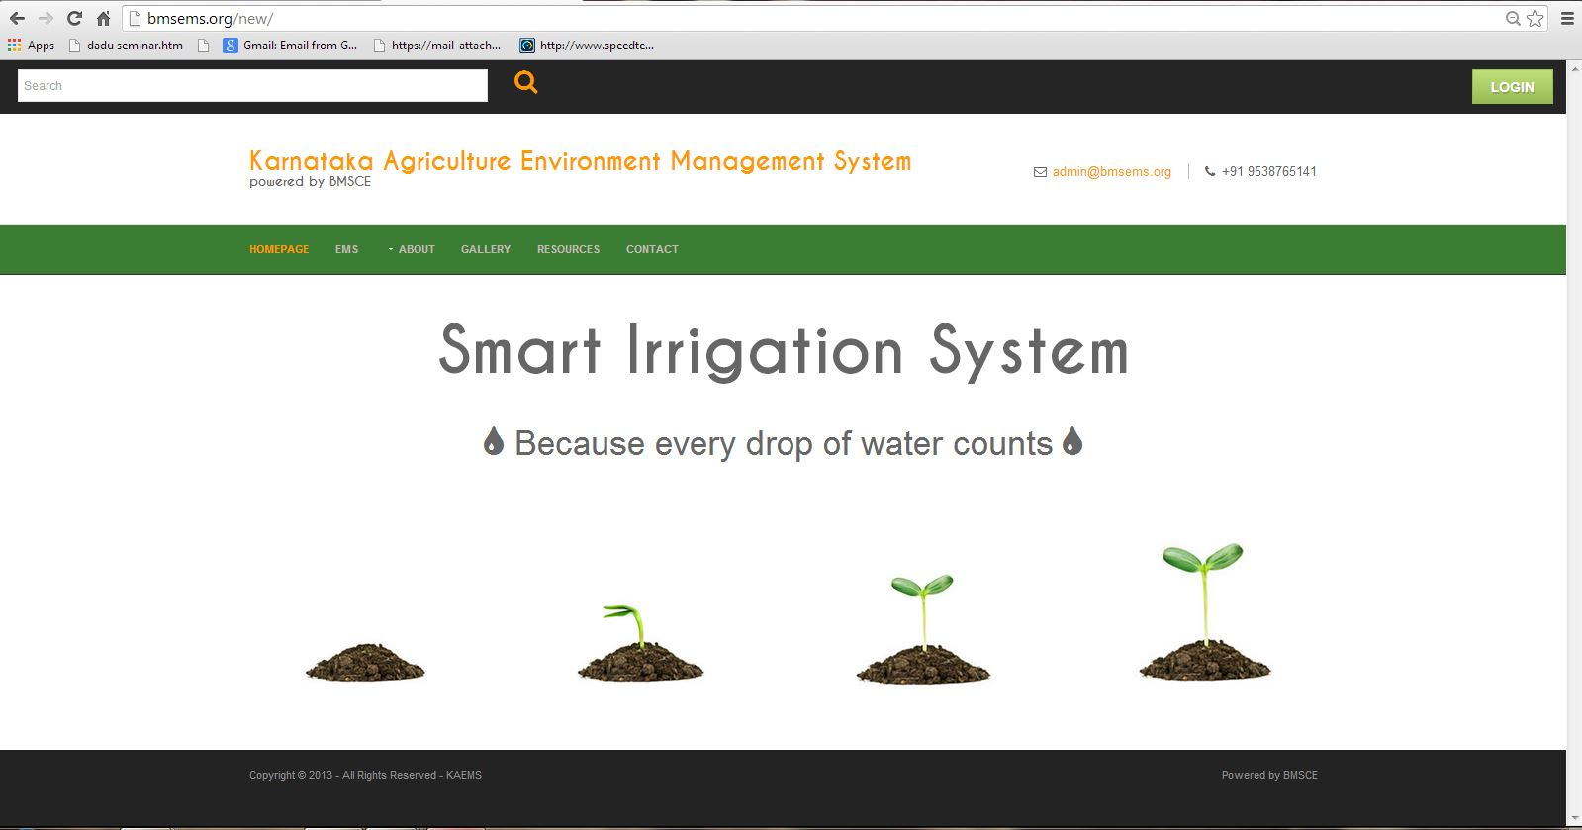
Remote Data Acquisition…
The web-link is: http://bmsems.org/new

Slide 9
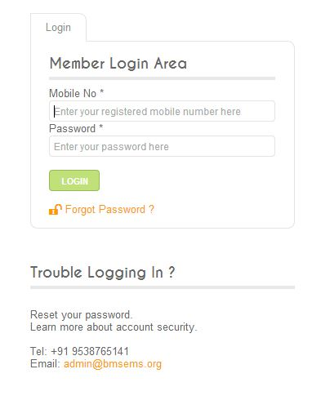
Welcome Page…
Each user is provided with his own distinct ID & a secret password through which he can access the required data.
This way both authentication of the identity and confidentiality of the data is maintained

Slide 10
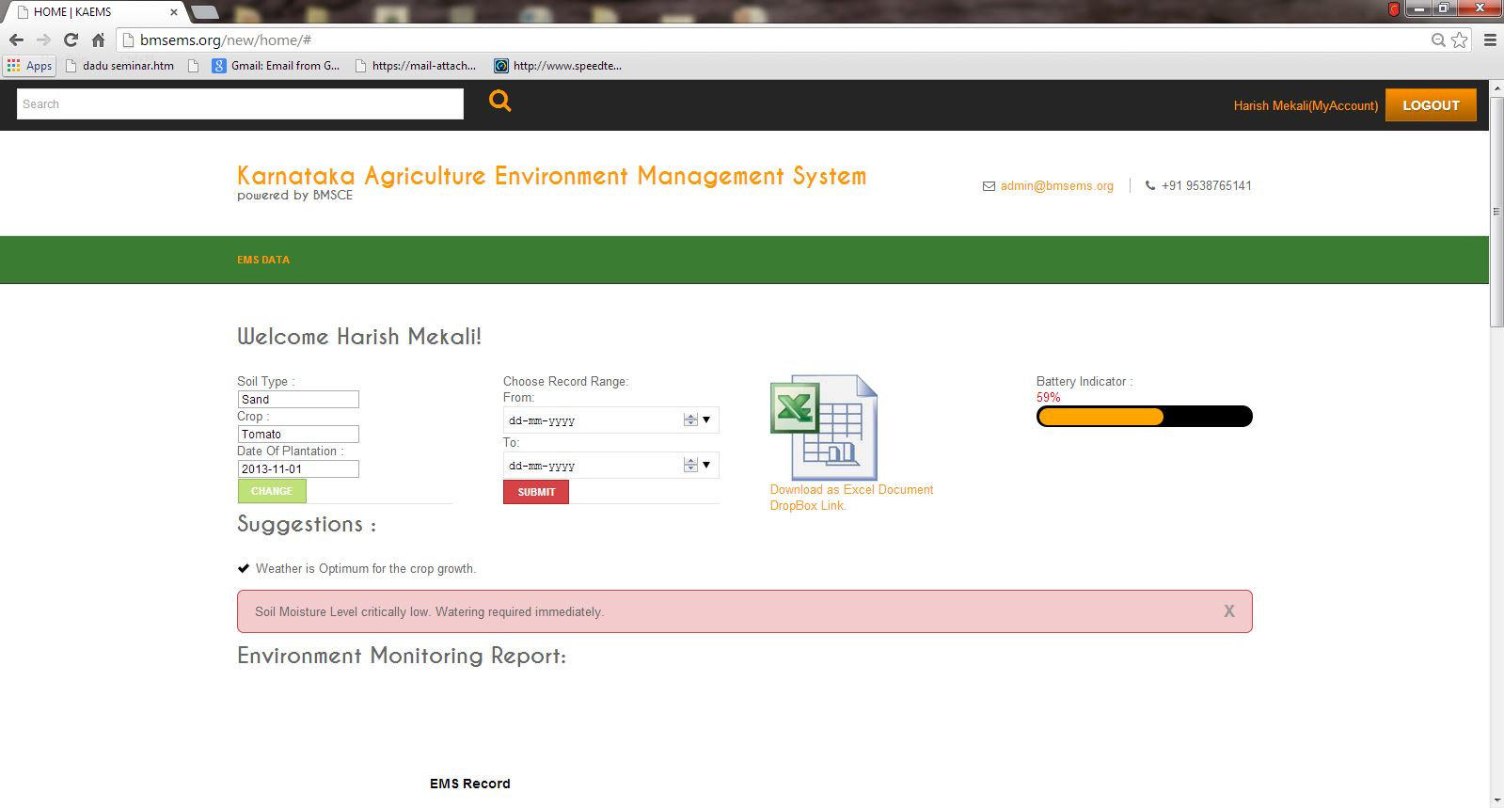
User Page…
The user has to login to the website as a member to access the data or use the website to read the parameter he wishes to get a hold on. For this he has to obtain the permission from the administrator.

Slide 11
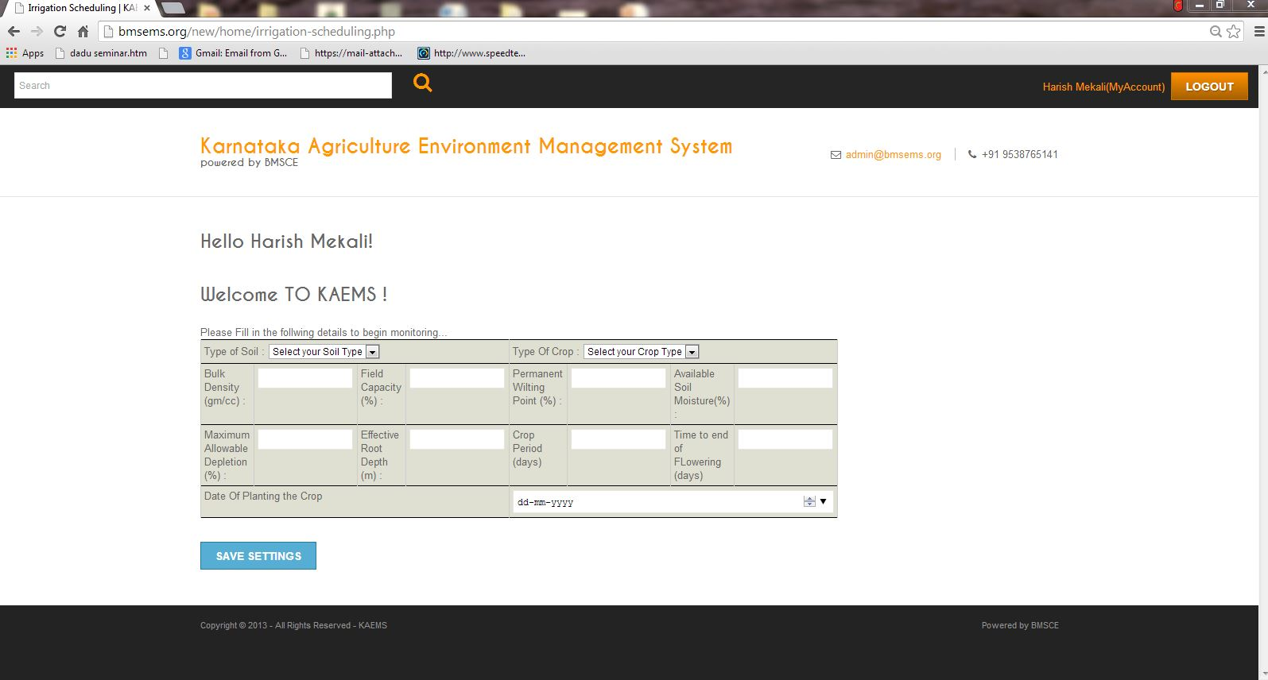
Data Page..
Initially we enter the information about soil type, crop and the date of plantation. This information is automatically updated to the database and based on this information our device controls the situation.

Slide 12
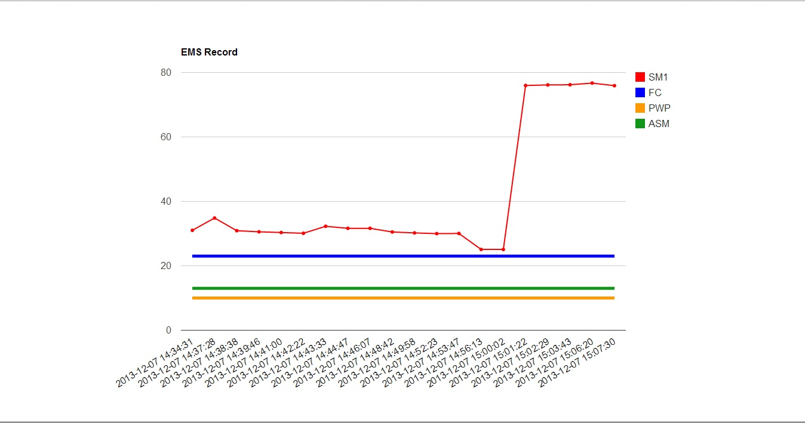
Graph
A graph displays the various sensor values employed, in detail and the output crop details along with the current battery percentage remaining.

Slide 13
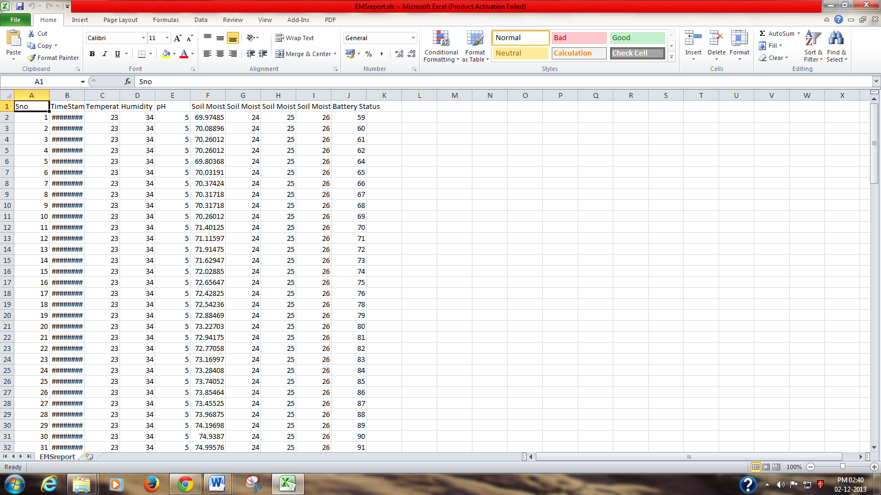
Excel Spreadsheet…
The various sensor data are collectively stored in an excel sheet which can be used later to analyse. The excel files are maintained in an archive format so that less capacity holds maximum amount of information.

Slide 14
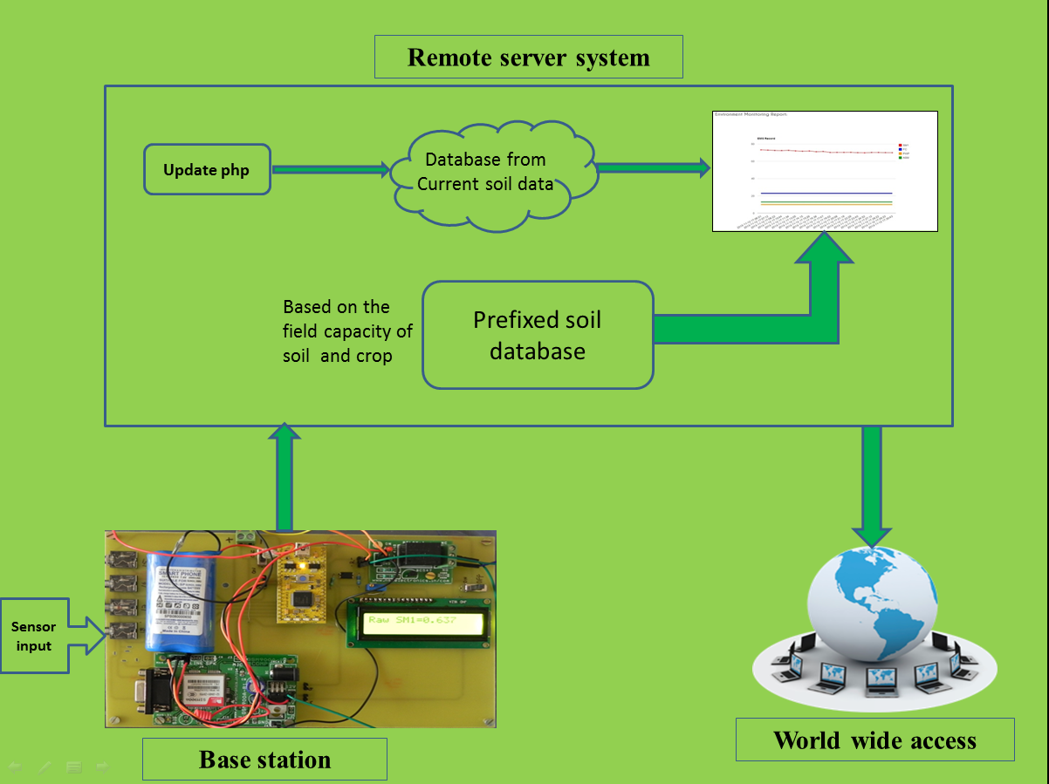
Working Model…

Slide 15
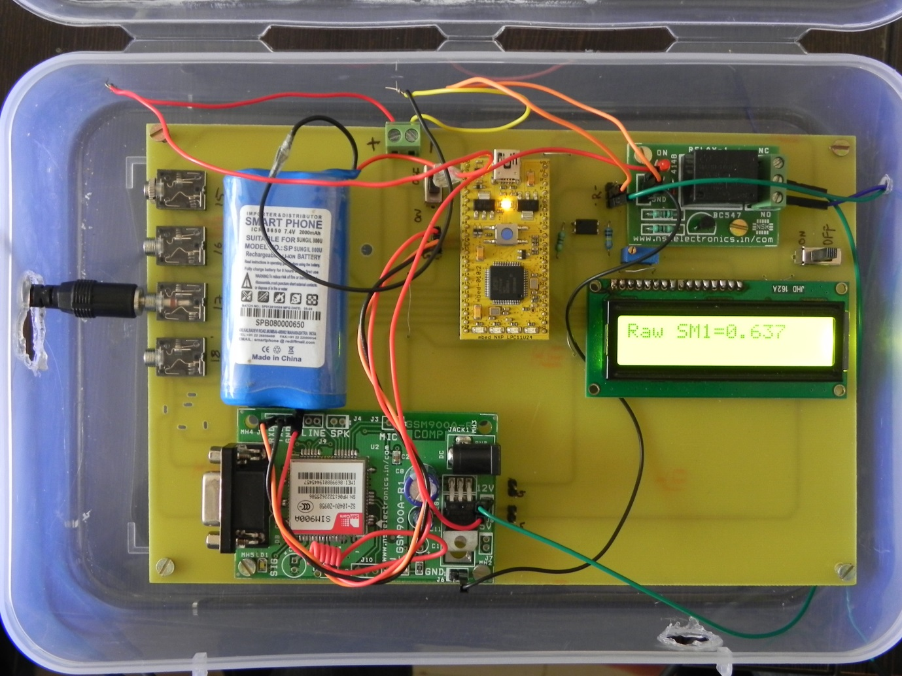

Demo

Slide 16
Conclusion
We proudly propose this idea to enhance the well-being of the farmers who reside at remote places to obtain the knowledge of their fields and crop information.
We feel glad to conclude that we have touched an effort of few technological fields, for sensible information management, making use of modern wireless communication such as GPRS

Slide 17
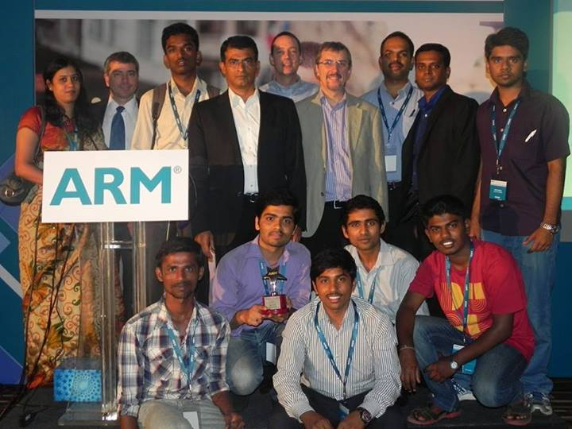
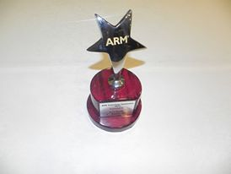
Recognition
2nd runner up in the ARM Symposium held at Le Meridian, Bangalore in the year 2013.

Slide 18
Future Work
Solar Panel
Low power up gradation
Autonomous power management system
Creating the wireless sensor network
Real tine implementation in the fields.
––––
Charger Unit
Display
Zigbee
Battery
Regulator
ARM Cortex
GPRS
GPS
Sensors

Slide 19



Sponsors…
TEQIP

Slide 20
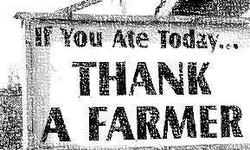
Thank You

